Slide 1
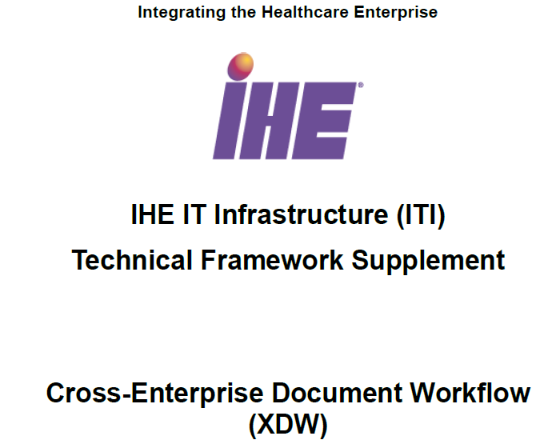
Early Hearing Detection and Intervension
Workflow Definition (EHDI-WD)

Slide 2
Content Updater
Share
Content Creator
Content Consumer

Slide 3
Vince – how do we handle the concent document requirements?
Secure XDS
XDS Source
XDS Repository
XDS Registry Facade
BPPC Document
XDS Consumer
XDS Registry
Enforces the BPPC constraints by shielding the actual XDS Registry
Same web service functionality as the XDS Registry
Connects to XDS Sources, Consumers and Repository
Not a registry-implementation, but a front-end around the actual XDS Registry
No data are stored in the XDS Registry Facade

Slide 4

Document Registry
2 – Query
Document Set
1 – Register document
Document Source
Document Repository
Document Consumer
3 – Retrieve
Document Set

Slide 5
Early Hearing Detection and Intervention - Workflow Definition (EHDI-WD)
Input documents
Tasks
Output documents
Create Hearing Plan of Care
Hearing Plan of Care
Hearing Plan of Care
| Standing Order
Order Request &
Consent
Conduct Hearing Screening
Results
Outcome Report
Discharge Newborn
Care Summary
Outcome Report|
Care Summary
Update Hearing Plan of Care
Hearing Plan of Care

Slide 6
Care
Summary
Generator
Order
Placer
Screening
Requester
Plan of Care
Manager
Birth
1
Create
HPofC
HPofC |
Std Order
2
Order Request
Consent
4
3
Result
Outcome Report
5
Order Request
6
The Conduct Screening task can be repeated, (based on local jurisdictional rules and other considerations)
Update
HPofC
4
Result
7
5
Update Outcome Report
6
Discharge
Update
HPofC
Care Summary
7
8
Update
HPofC
9
Note: for an XDW workflow, the arrows represent a sharing through XDS*

Slide 7
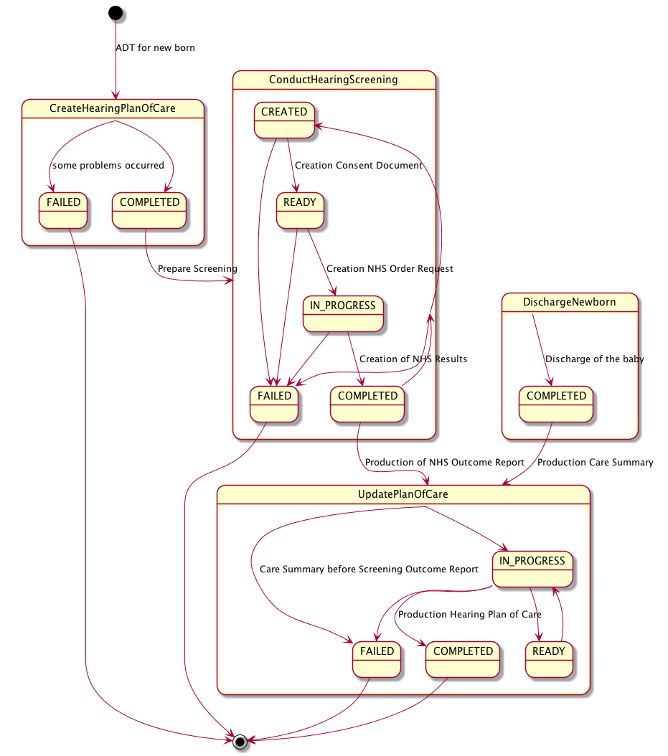

Slide 8
ADT Notification of Birth
Create Hearing Plan of Care
FAILED
COMPLETED
During IN-PROGRESS, if the screening procedure is not performed for some reason, the returned results negate the procedure requested to be performed and provide the reason for not performing it.
Hearing Plan of Care is created
Conduct Hearing Screening
Screening is consented and performed
Repeat
Screening
System takes
ownership
Order Request
Returned
Results
FAILED
CREATED
READY
IN-PROGRESS
COMPLETED
Consent Obtained
The HPoC can’t be
Processed correctly.
The consent is not obtained within some period of time.
Outcome Report
Is created
Discharge Newborn
Care Summary arrives and no Outcome Result
Report is present.
COMPLETED
Care Summary is created
Update Hearing Plan of Care
Outcome Report
Updated
Outcome
Report
Care
Summary
FAILED
READY
IN-PROGRESS
COMPLETED
TBR meeting
The Outcome Report can’t be
Processed correctly.
Hearing Plan of Care is Updated

Slide 9
EHDI-WD workflow steps (Part 1)
1
2
PH is notified of birth
Care Plan is generated with demographic info.
Output: Hearing Plan of Care
Create Workflow
Document
Update Workflow Document
EHDI-WD Document
EHDI-WD Document
Create Plan of Care
Status: COMPLETED
Create Plan of Care
Status: COMPLETED
TaskEvent History
TaskEvent History
TaskEvent: 1
Status:
Input: N/A
Output:
TaskEvent: 1
Status: COMPLETED
Input: N/A
Output: Hearing Plan of Care

Slide 10
EHDI-WD workflow steps (Part 2)
3
4
5
6
Consent is obtained.
Screening is requested.
Screening is performed.
Screening outcome is assessed.
Output: Signed Consent
Output: Order Request
Output: Result
Output: Outcome Report
Update Workflow Document
Update Workflow Document
Update Workflow Document
Update Workflow Document
EHDI-WD Document
EHDI-WD Document
EHDI-WD Document
EHDI-WD Document
Create Plan of Care
Create Plan of Care
Create Plan of Care
Create Plan of Care
Conduct Screening
Status: CREATED
Conduct Screening
Status: READY
Conduct Screening
Status: IN_PROGRESS
Conduct Screening
Status: COMPLETED
TaskEvent History
TaskEvent History
TaskEvent History
TaskEvent History
TaskEvent: 1
Status: CREATED
Input: Hearing Plan of Care
Output: Signed Consent
TaskEvent: 1
TaskEvent: 1
TaskEvent: 1
TaskEvent: 2
Status: READY
Input: Signed Consent
Output: Order Request
TaskEvent: 2
TaskEvent: 2
TaskEvent: 3
Status: IN_PROGRESS
Input: Order Request
Output: Result
TaskEvent: 3
TaskEvent: 4
Status: COMPLETED
Input: Result
Output: Outcome Report

Slide 11
EHDI-WD workflow steps (Part 3)
7
8
9
Plan of Care is updated
Newborn is discharged.
Plan of Care is updated
Output: Hearing Plan of Care
Output: Care Summary
Output: Hearing Plan of Care
Update Workflow Document
Update Workflow Document
Update Workflow Document
EHDI-WD Document
EHDI-WD Document
EHDI-WD Document
Create Plan of Care
Create Plan of Care
Create Plan of Care
Conduct Screening
Conduct Screening
Conduct Screening
Update Plan of Care
Status: IN_PROGRESS
Update Plan of Care
Update Plan of Care
Status: COMPLETED
TaskEvent History
Discharge Newborn
Status: COMPLETED
TaskEvent History
TaskEvent: 1
Status: IN_PROGRESS
Input: Outcome Report
Output: Hearing Plan of Care
TaskEvent History
TaskEvent: 1
TaskEvent: 1
Status: COMPLETED
Input: N/A
Output: Care Summary
TaskEvent: 2
Status: COMPLETED
Input: Care Summary
Output: Hearing Plan of Care
Discharge Newborn

